Slide 1
频率原则理解与应用
许志钦
2023年10月2日

Slide 2
Understanding generalization

Slide 3
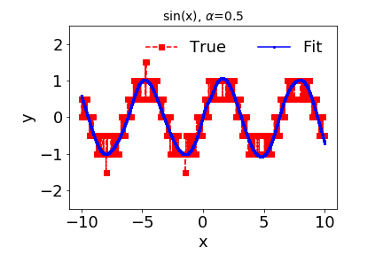
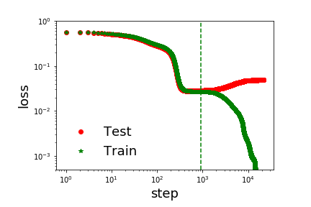
Effect of early stopping
1807.01251

Slide 4
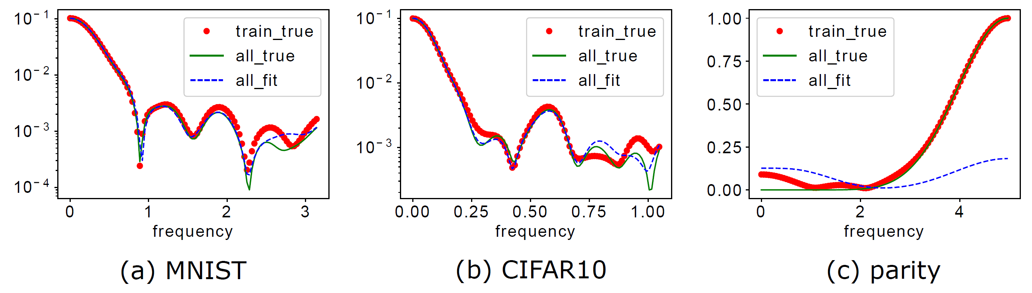
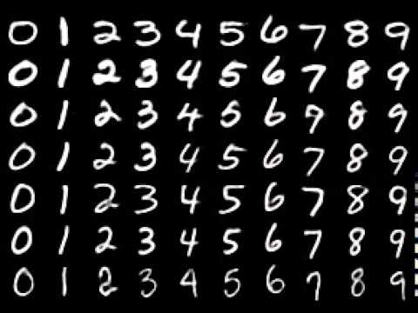
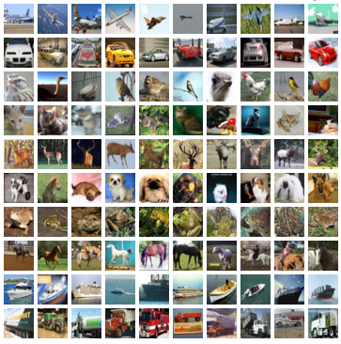
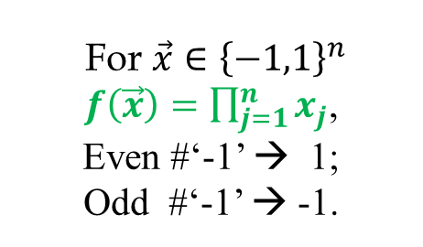
Generalization difference
F-Principe: DNN prefers low frequencies
For $\vec{x}∈{\left\{−1,1\right\}}^{n}$
$f\left(\vec{x}\right)=\prod_{j=1}^{n}{x_{j}}$,
Even #‘-1’ → 1;
Odd #‘-1’ → -1.
Test accuracy: 96.3%>>10%
Test accuracy: 72% %>>10%
Test accuracy: ~50%, random guess
1901.06523

Slide 5

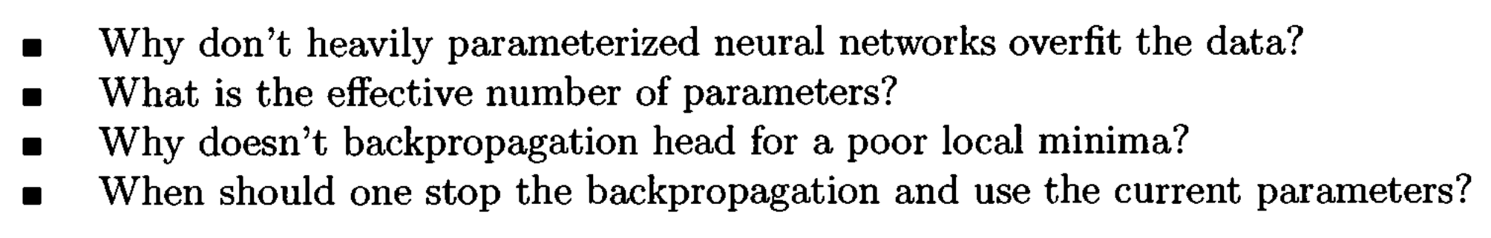
Long-standing problems
1995
Frequency principle is independent of network size!
For many cases, early-stopping avoids fit high-frequency noise!
Leo Breiman, 1995

Slide 6
MscaleDNN
Liu, Cai, Xu*, MscaleDNN, 2007.11207, CiCP

Slide 7
Radial scaling in k-space
Liu, Cai, Xu*, MscaleDNN, 2007.11207, CiCP

Slide 8
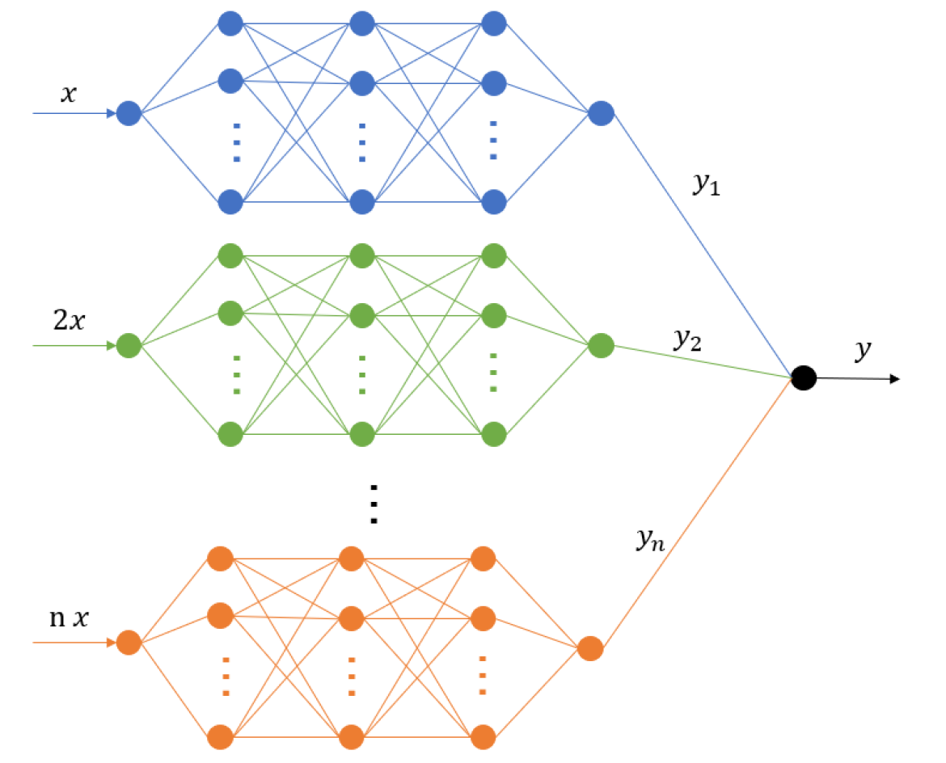
MscaleDNN structures
Giving a MscaleDNN
$f\left(x\right)=\sum_{i=1}^{10}{a_{i}σ(w_{i}x+b_{i})}$+ $\sum_{i=11}^{20}{a_{i}σ(2w_{i}x+b_{i})}$+ $\sum_{i=21}^{30}{a_{i}σ(3w_{i}x+b_{i})}$
Liu, Cai, Xu*, MscaleDNN, 2007.11207, CiCP

Slide 9
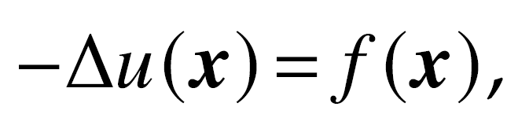
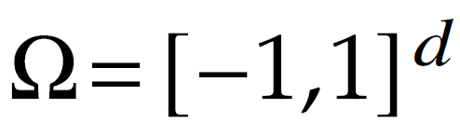
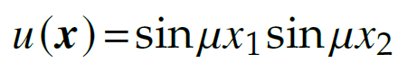
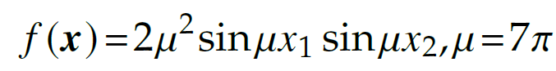
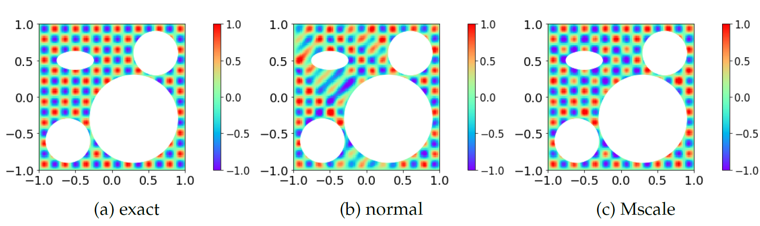
Two dim case: complex domain
Liu, Cai, Xu*, MscaleDNN, 2007.11207, CiCP

Slide 10
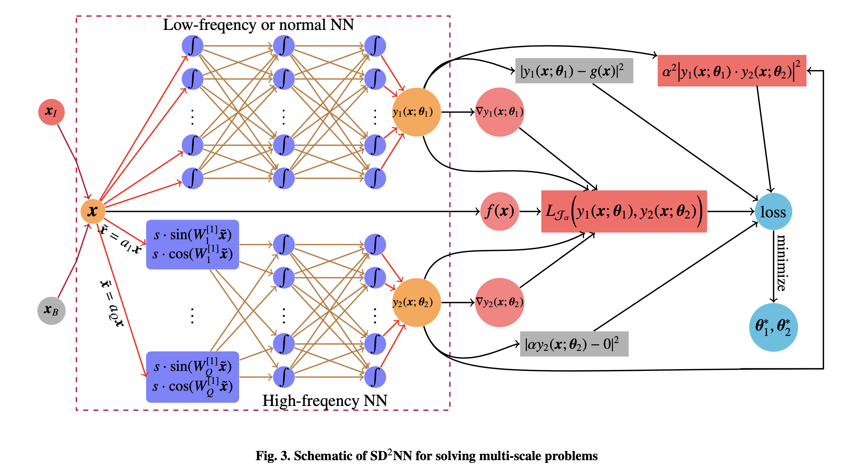
Sub-space decomposition
Xi-An Li, Zhi-Qin John Xu, Lei Zhang * , SD2NN, arxiv 2112.06660

Slide 11
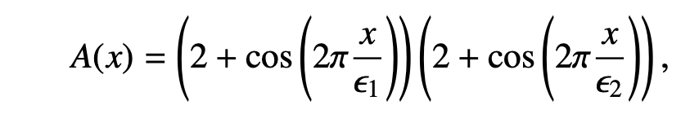
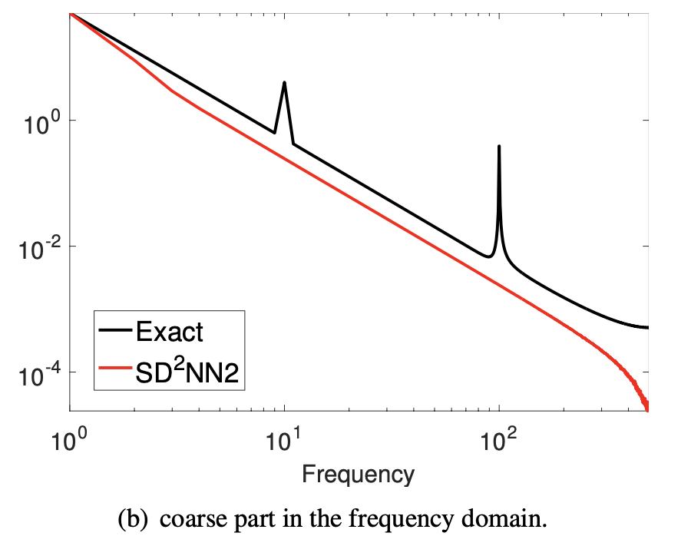
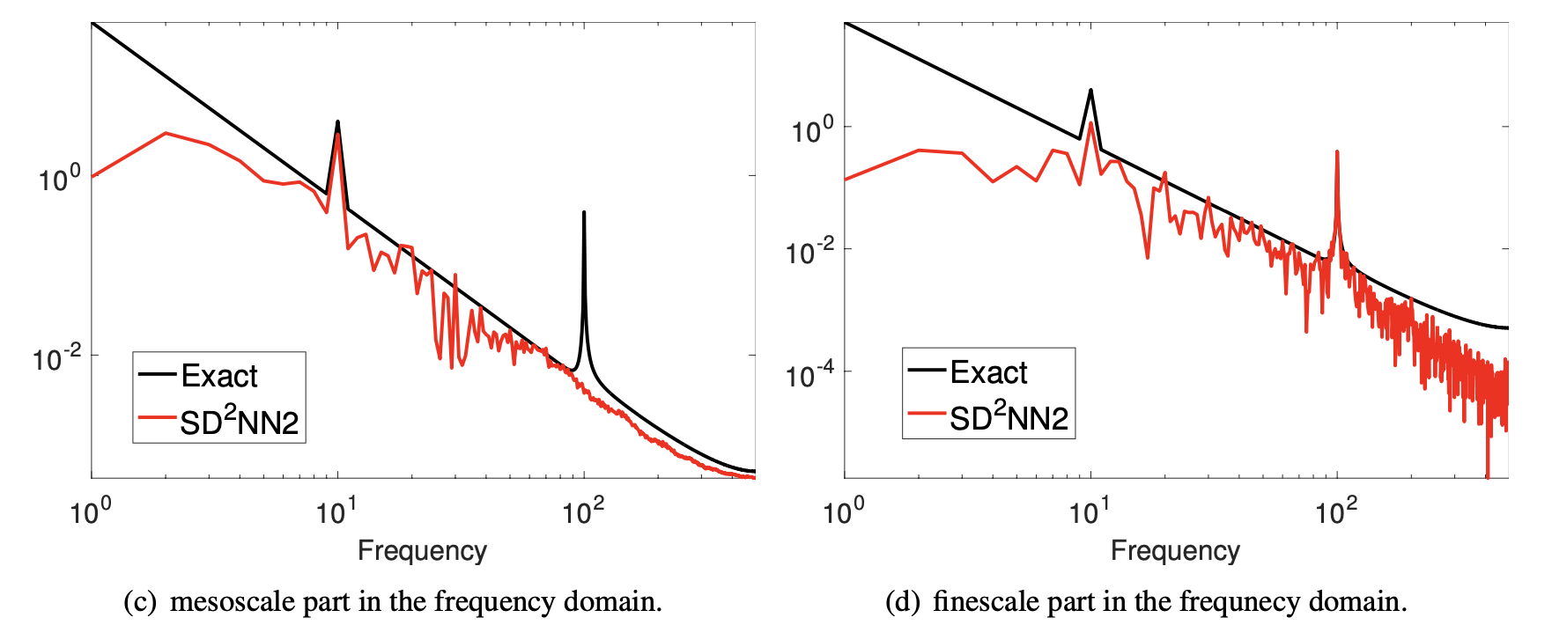
Sub-space decomposition
Xi-An Li, Zhi-Qin John Xu, Lei Zhang * , SD2NN, arxiv 2112.06660

Slide 12
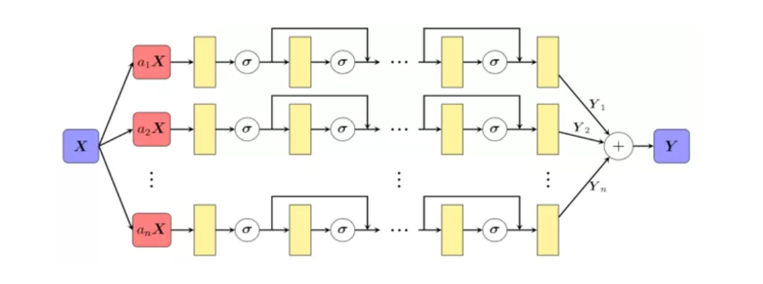
Huawei：MindSpore Science for Maxwell equations
Huang X et al. Solving Partial Differential Equations with Point Source Based on Physics-Informed Neural Networks, arXiv:2111.01394, 2021

Slide 13
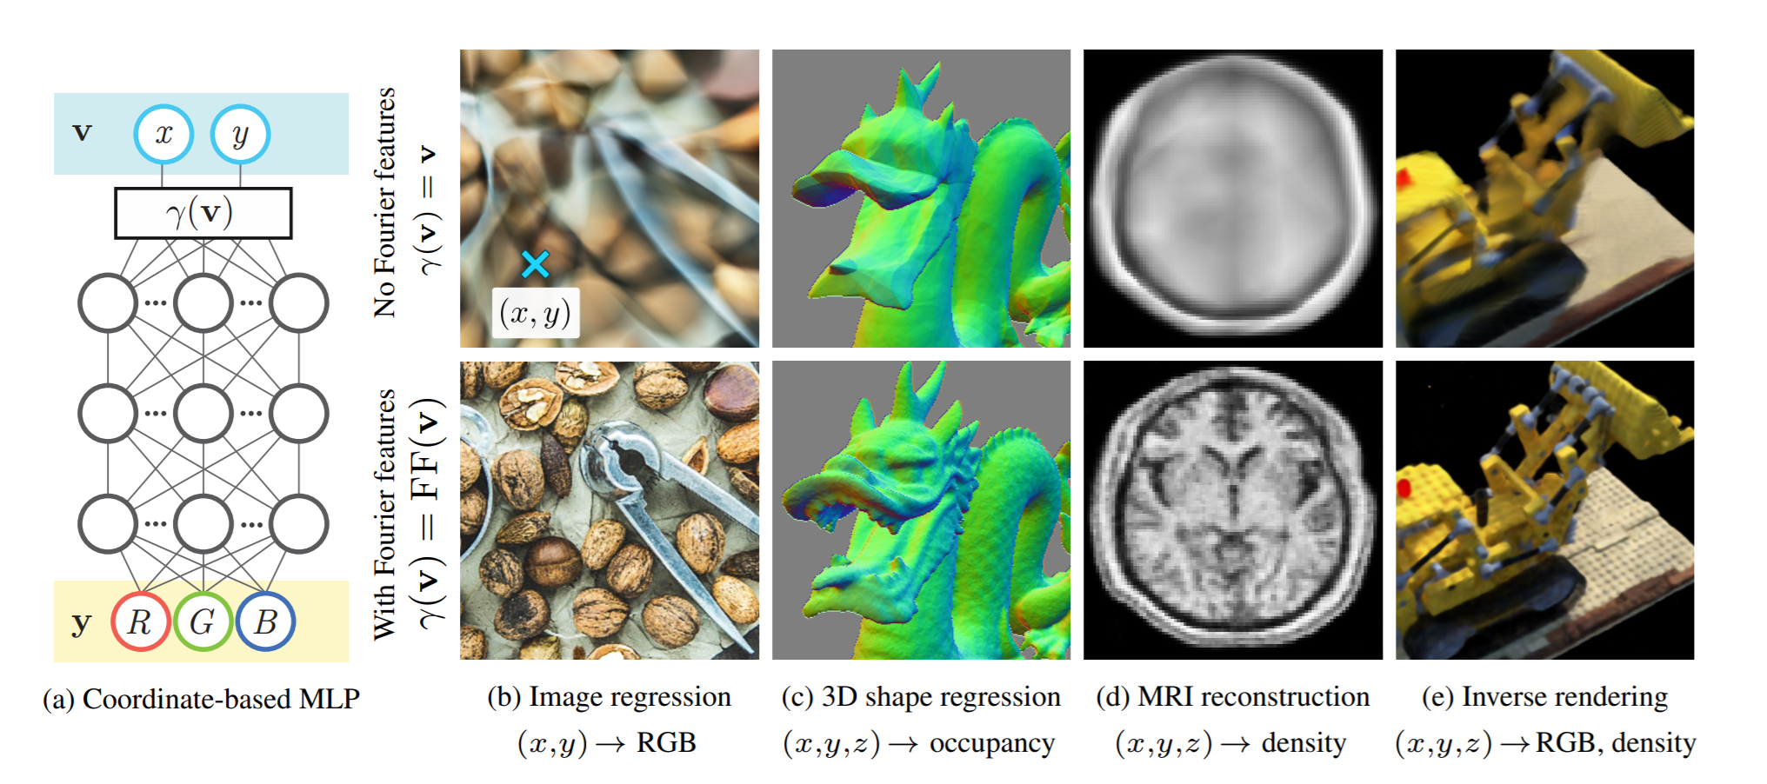
Fourier Features Let Networks
Tancik et al., 2020

Slide 14
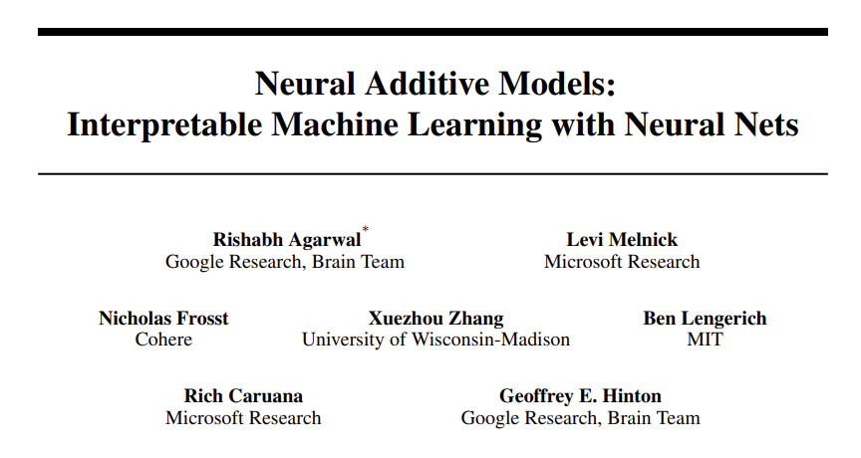
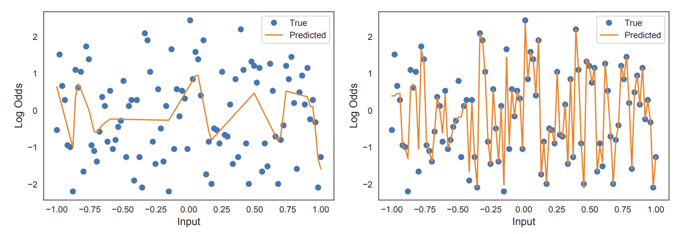
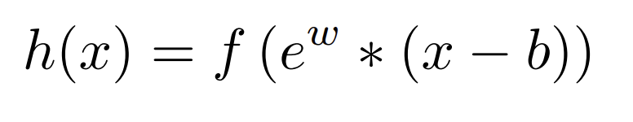
Exp-centered (ExU) hidden units (Hinton’s group)
Exp-centered (ExU) hidden units

Slide 15
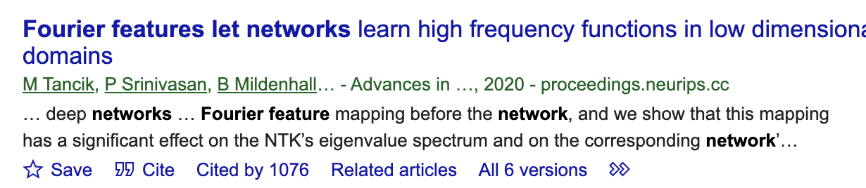
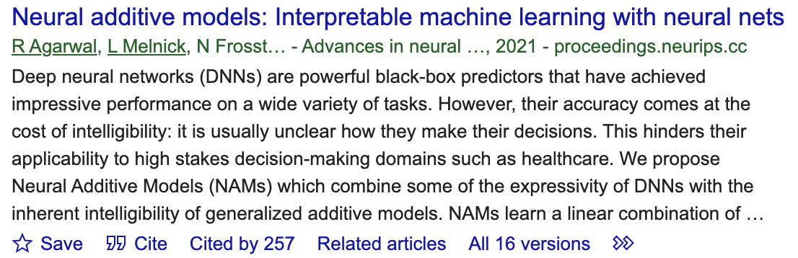
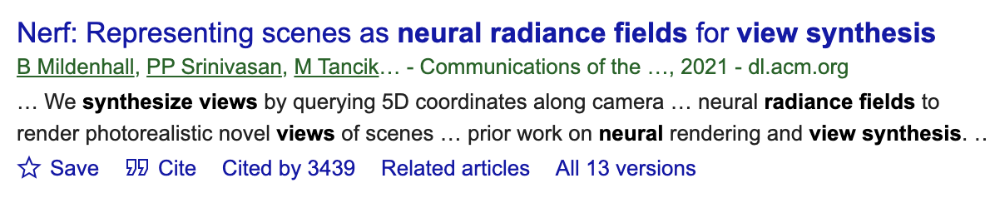
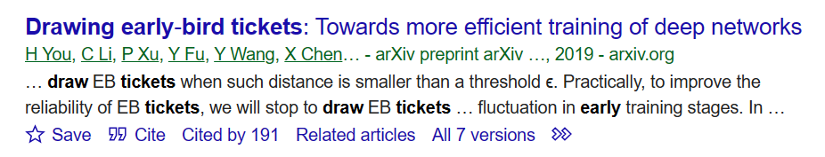
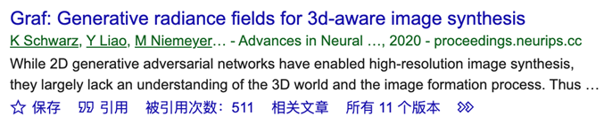
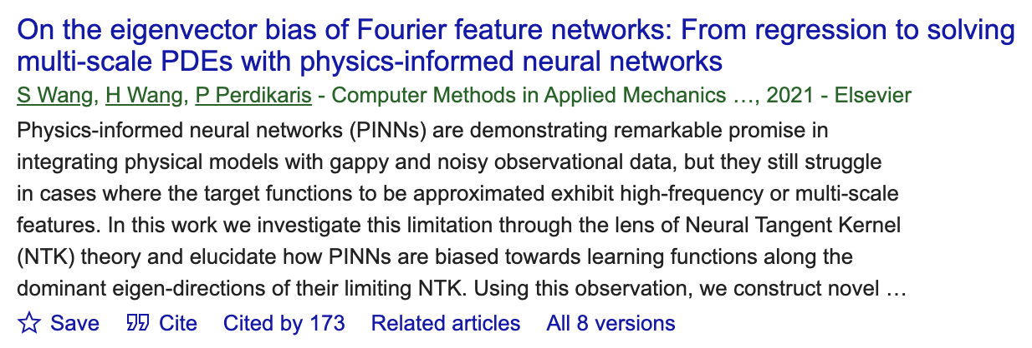
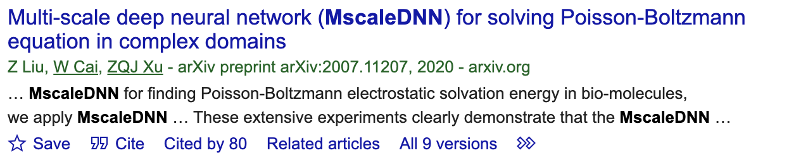
频率原则启发的算法设计得到广泛使用

